Slide 1
Wireless LAN
Security
Chapter 12

Slide 2


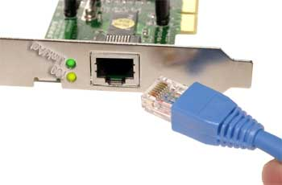
What is a wireless LAN?
Wireless LAN (WLAN) - provides all the features and benefits of traditional LAN technologies such as Ethernet and Token Ring, but without the limitations of wires or cables.

Slide 3

What is a wireless LAN?
WLAN, like a LAN, requires a physical medium to transmit signals.
Instead of using UTP, WLANs use:
  Infrared light (IR)
    802.11 does include an IR specification
    limitations, easily blocked, no real 802.11 products (IrDA)
  Radio frequencies (RFs)
    Can penetrate ‘most’ office obstructions

Slide 4
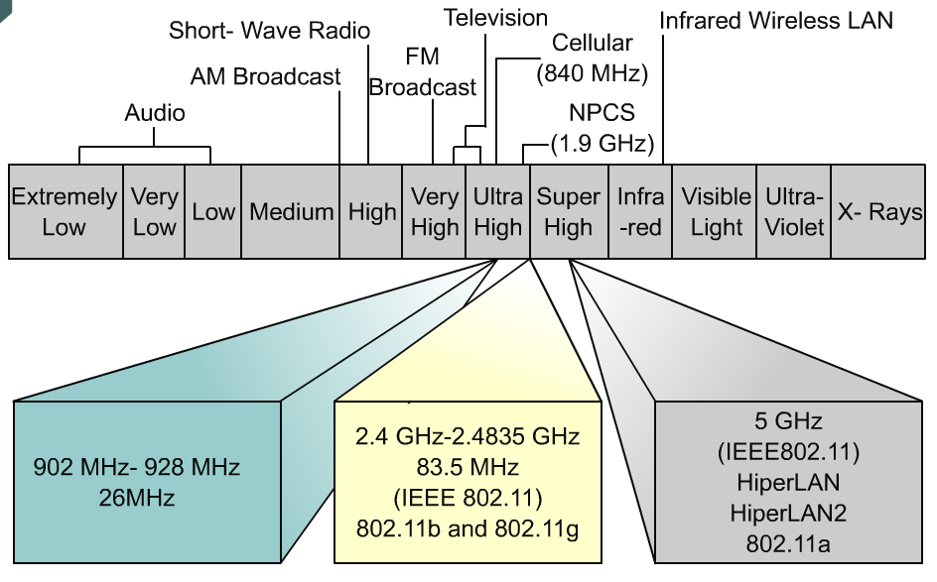
What is a wireless LAN?
WLANs use the 2.4 GHz and 5-GHz frequency bands.
ISM (Industry, Scientific, Medical) license-free (unlicensed) frequency bands.
S-Band ISM
  802.11b and 802.11g: 2.4- 2.5 GHz
C-Band ISM
  802.11a: 5.725 – 5.875 GHz

Slide 5
Current Standards – n, ac, ax
Speed
860 Kbps
1 and 2 Mbps
54 Mbps
1 and 2 Mbps
11 Mbps
Network
Proprietary
Standards-based
Radio
900 MHz
2.4 GHz
2.4 GHz
5 GHz
IEEE 802.11Begins Drafting
802.11
Ratified
802.11a,b
Ratified
802.11g
Ratified
1986
1988
1990
1992
1994
1996
1998
2000
2003
802.11n
  Up to 600Mbps
  2.4GHz & 5GHz
802.11ac
  Up to 6Gbps
  Backward compatible
802.11ax
  Up to 10Gbps
  5GHz

Slide 6
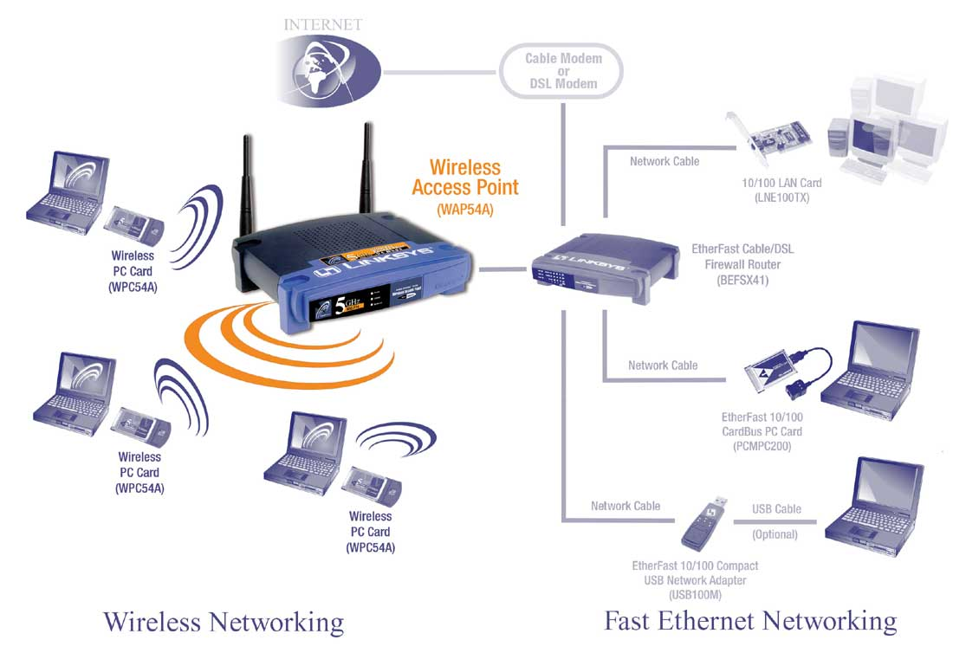
WLAN setup: Basic Terms
Source from Linksys

Slide 7
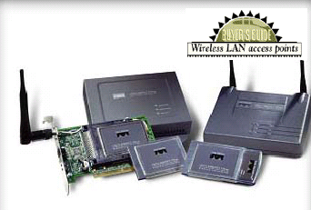
Wireless Access Point
An access point (AP) has three main parts
  An antenna and a radio transmitter/receiver
  An RJ-45 wired network interface to connect to a wired network
  Special bridging software
Access point has two basic functions
  Acts as base station for wireless network
  Acts as bridge between wireless and wired network

Slide 8
SSID for WLAN
Service Set Identifier (SSID) is a sequence of characters that uniquely names a WLAN.
SSID is attached to the header of packets sent over a WLAN that acts as a password when a mobile device tries to connect to the Access Point.
The SSID differentiates one WLAN from another, so all access points and all devices attempting to connect to a specific WLAN must use the same SSID.
SSID is also referred to as a Network Name because it is a name that identifies a wireless network.

Slide 9
Good Practise for Administering SSID
Some common mistakes in administering SSID are listed below:
  Using default SSID
  Using SSID as a means of securing wireless networks
  Unnecessary broadcasting of SSID.

Slide 10

Risks in Wireless network
War Driving / Network Sniffing
Man-in-Middle attack
Denial of Service Jamming
Impersonating / IP spoofing
Most of these risks can be prevented using authentication and encryption methods

Slide 11
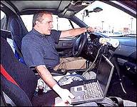
Wardriving
An act of searching for Wi-Fi wireless networks by a person in a moving vehicle, using a portable computer
Aim is to look for unsecured WLANs to gain illegal access
War walking is the equivalent of searching for wireless networks by walking in foot

Slide 12
Threats from wardriving
Many companies with WLANs do not employ basic authentication
Upon discovery of WLAN’s presence, crackers can join the organisations’ networks and do the following:
  Gain illegal access to network usage
  Access of confidential files
  Upload trojan or virus programs within the network environment

Slide 13
802.11 Security Mechanism
Authentication
  Either uses Open System (null authentication) or Shared Key (Challenge-response based on WEP) method
Encryption
  Intended to provide a level of security comparable to that of a wired LAN
  Security protocol is known as Wired Equivalent Privacy (WEP)
Media Access Control (MAC) list
  Configuring a list of physical addresses of wireless clients in Access Points that are permitted to access the wireless network.

Slide 14
Wired Equivalent Privacy (WEP)
WEP relies on a secret key that is shared between a mobile station (e.g. a laptop with a wireless ethernet card) and an access point (i.e. a base station).
A WEP key is an alphanumeric character string used in 2 manners in a wireless LAN.
  Can be used to verify the identity of an authenticating station
  Can be used to encrypt packets before they are transmitted, and an integrity check is used to ensure that packets are not modified in transit.

Slide 15
Wired Equivalent Privacy (WEP)
Security protocol operating at the data link layer
Used for encrypting wireless traffic using RC4 encryption
Configured in 3 possible modes
  No encryption mode
  40 bit encryption key
  104 bit encryption key
Uses 24 bit Initialization Vector (IV)
64-bit WEP (root key + IV)
  String of 10 hexadecimal characters (4 bits each)
  (10 * 4) + 24 IV = 64 bits
128 bit WEP (root key + IV)
  String of 26 hexadecimal characters (4 bits each)
  (26 * 4) + 24 IV = 128 bits

Slide 16
Weaknesses of WEP
The IV is too small and in clear text.
  It's a 24-bit field sent in the clear text portion of a message. This 24-bit string, used to initialize the key stream generated by the RC4 algorithm, is a relatively small field
The IV is static.
  Reuse of the same IV produces identical key streams for the protection of data
The IV makes the key stream vulnerable.
  The 802.11 standard does not specify how the IVs are set or changed, and individual wireless adapters from the same vendor may all generate the same IV sequences, or some wireless adapters may possibly use a constant IV. As a result, hackers can record network traffic, determine the key stream, and use it to decrypt the ciphertext.

Slide 17
Weaknesses of WEP
The IV is a part of the RC4 encryption key.
  The fact that an eavesdropper knows 24-bits of every packet key, combined with a weakness in the RC4 key schedule, leads to a successful analytic attack that recovers the key after intercepting and analyzing only a relatively small amount of traffic.
WEP provides no cryptographic integrity protection.
  Integrity Check Value (ICV) is based on CRC-32, an algorithm for detecting noise and common errors in transmission.
  CRC-32 is an excellent checksum for detecting errors, but an awful choice for a cryptographic hash.
No WEP key management
  WEP keys are manually entered into the AP
Notes:
Countermeasure for poor 802.11 WEP key management is 802.1x and 802.11i Key management for Dynamic WEP
Need to improve WEP key management to ensure that different key is used for each encryption/authentication using RC4 stream cipher. Different key input RC4 results in different keystream.

Slide 18
How to defend when using WEP
Use longer WEP encryption keys, which makes the data analysis task more difficult. If your WLAN equipment supports 128-bit WEP keys.
Change your WEP keys frequently. There are devices that support "dynamic WEP" which is off the standard but allows different WEP keys to be assigned to each user.
Use a VPN for any protocol, including WEP, that may include sensitive information.
Implement a different technique for encrypting traffic, such as IPSec over wireless.

Slide 19
WEP Solution
Short-Term (WPA):
  Uses Temporal Key Integrity Protocol (TKIP)
  Can be implemented on existing hardware platforms while still providing acceptable security in the short term future
Long-Term (WPA2 802.11i):
  One based on AES will be used for future devices
Notes:
Uses a stopgap measure called TKIP (Temporal Key Integrity Protocol)

Slide 20
What is WPA?
Wi-Fi Protected Access is a specification of standards-based, interoperable security enhancements, which strongly increase the level of data protection and access control for existing and future Wi-Fi wireless LAN system.
Wi-Fi Protected Access (WPA) is a response by the WLAN industry to offer an immediate, strong security solution
WPA is intended to be a solution to replace WEP
  A software and firmware upgrade to existing access points. Support legacy hardware.
WPA is a subset of the 802.11i draft standard and is expected to maintain forward compatibility with the standard
Notes:
Uses a stopgap measure called TKIP (Temporal Key Integrity Protocol)

Slide 21
How WPA addresses WEP vulnerabilities
Extended 48-bit IV (longer IV)
A Message Integrity Code (MIC) called Michael to defeat tampering. It overcomes the vulnerabilities of CRC
Dynamic Key Derivation and Distribution
  Temporal Key Integrity Protocol
802.1x Authentication
Notes:
TKIP Sequence counter or TSC. IV doubles up as a sequence counter to help detect replay attack

Slide 22
  Temporal Key Integrity Protocol (TKIP)
RC4 key is used to encrypt one packet. Hence, TKIP dynamically generates a new RC4 key for each packet.
Consists of 128 bit secret shared key called Temporal Key
Temporal Key + Host MAC address + IV (48 bits) to generate key for RC4 encryption
Temporal Key is changed every 10,000 packets
Notes:
TKIP Sequence counter or TSC. IV doubles up as a sequence counter to help detect replay attack

Slide 23
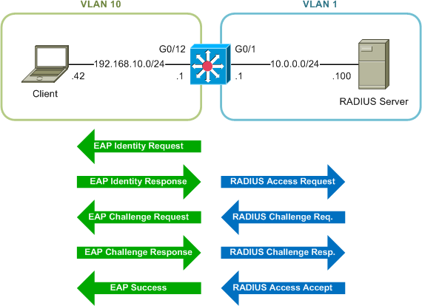
How does 802.1x Authentication work
Wireless AP

Slide 24
WPA2
Implemented as IEEE802.11i
Defines a new type of wireless network called Robust Security Network (RSN)
Uses CCMP, an AES-based encryption protocol
  More secured but slower than TKIP used in WPA

Slide 25
What is CCMP?
Counter Mode with Cipher Block Chaining Message Authentication Code Protocol
It is the equivalent of TKIP in WPA.
CCMP computes a Message Integrity Check (MIC) using the well known, and proven, Cipher Block Chaining Message Authentication Code (CBC-MAC) method.
Changing even one bit in a message produces a totally different result.

Slide 26
Wireless Security Key Features Comparison
WEP
WPA
WPA2
Cipher
RC4
RC4
CCMP (AES)
Key Size
40 or 104 bits
128 bits
128 bits
Key Life
24 bits IV, wrap
48 bits IV
48 bits IV
Packet Key
Concatenated
Mixing Function
Not Needed
Header Integrity
None
Michael
CCMP (AES)
Data Integrity
ICV/CRC-32
Michael
CCMP (AES)
Replay Protection
None
Use IV
Use IV
Key Management
None
EAP based
EAP based
Authentication
Open/Shared
Strong user authentication using 802.1X & EAP
Strong user authentication using 802.1X & EAP

Slide 27
Wireless Security Tips
Change Your Default SSID
  Hackers Know Manufacturers Default SSIDs, AND Passwords
Don’t Make Your SSID Descriptive
  Company Name, Location, Division, etc.
Disable “Broadcast SSID” if Possible
  “Broadcast” is the Default!
Change Access Point/Router Passwords
  Follow Generally Acceptable Practices for Passwords
Upgrade Your Access Points Firmware
Enable WPA2, WPA or WEP

Slide 28
Wireless Security Tips
MAC Address Authentication
  Maintain a list of allowable MAC addresses and program them into each access point
Enforce the use of 2-factor authentication whenever using network resources
Assign static IP addresses to stations and disable DHCP
Logically place the AP in a DMZ with a firewall between the AP and internal network
Deploy an IDS to monitor network traffic between the AP and wired network

Slide 29
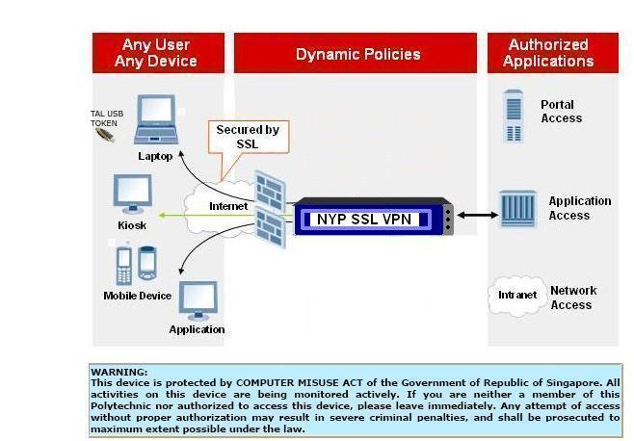
Wireless Security Tips
Adopt wireless VPN
  Tunnel all wireless traffic through VPN
  Use IPSec or SSL VPN

Slide 30
Wireless Security Tips
Plan Your Wireless Network Carefully
  Location of APs to Minimize Signal Distribution Outside of Building
Minimize signal leakage through directional antennas
Ensure audit trails are enabled especially when there are heavy network access from the wireless network segment

Slide 31
THE END

